Slide 1

Application of Model Predictive Control for Optimal Operation of Wind Turbines
Yuan Yuan, Pei Cao, and Jiong Tang
Mar 27, 2017
SPIE Smart Structures NDE Conference 2017
Department of Mechanical Engineering
University of Connecticut
Storrs, CT, USA
Dynamics, Sensing, and Controls Laboratory
Notes:
1

Slide 2
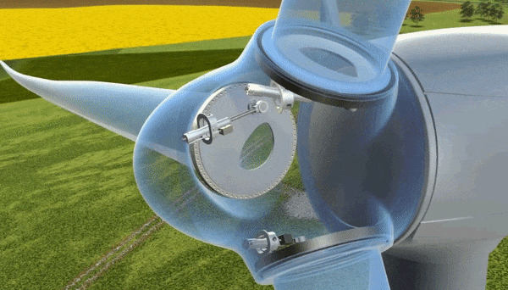
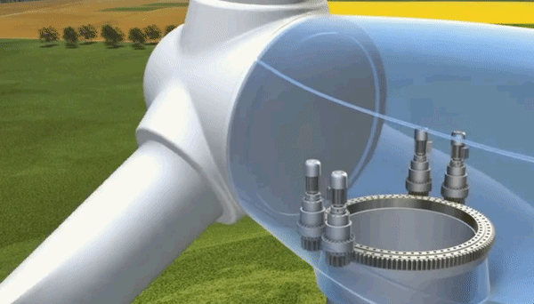
Background: Wind Turbine and Control
Wind Energy
Fastest growing renewable energy source in the world: The worldwide wind capacity reached over 400,000 MW by the end of 2015
Low cost & environmentally friendly
Pitch control animation
Wind turbine control loops
Generator torque control
Blade pitch control
Nacelle yaw control
Yaw control animation

Slide 3

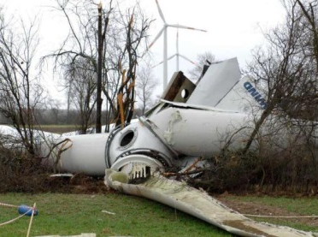
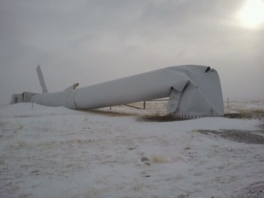

Multiple Objectives in Wind Turbines
Different control goals
Speed control
Power control
Load reduction on blades, tower and drive-train
Prolong actuator life
Challenges of multiple objectives
Designing individual controllers for each objective is getting more and more complex
Conflicting with each other
We need one controller that can balance all the objectives together
Model predictive control:
Online optimization of multiple control objectives
Notes:
To reduce the overall cost, we have several…first we need the speed control to keep the rotor at the rated value when wind speed is very high. If the rotor is over-speed, it will cause the over-heat of the generator and make the turbine on fire as shown in the first figure.
Also we want the power control, to make sure we capture the maximum power from wind when wind speed is not that high.
In addition, we can see there are a lot of components failure, the tower may fall and blade may crack. We need to reduce the loads.
Also, the life of actuators has its limit, changing them too often will increase more costs. So that we need to prolong the actuator life.
However,…..it is quite challenging when we realize multiple objectives
In this research, we choose MPC to achieve the optimization….

Slide 4
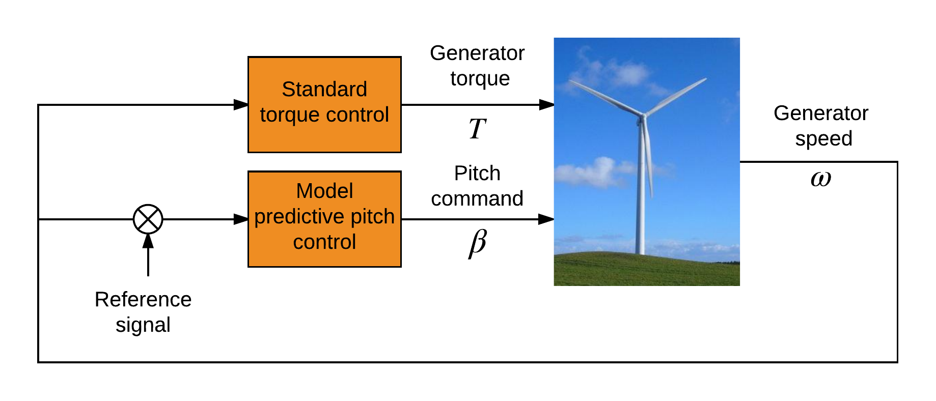
Control Architecture
-
Torque control: Standard torque control
Pitch control: Model predictive control
Yaw control: Not involved
Notes:
The yaw control is not involved, similar to other studies.

Slide 5
Switching Region Performance
Wind fields:
11 m/s, 12 m/s, 13 m/s
Results:
Power: Nearly same
Speed : better
Tower fore-aft loads: reduced
Tower side-side loads: mixed
Blade edgewise loads: nearly same
Blade flapwise loads: reduced
Pitch actuator: reduced

Slide 6


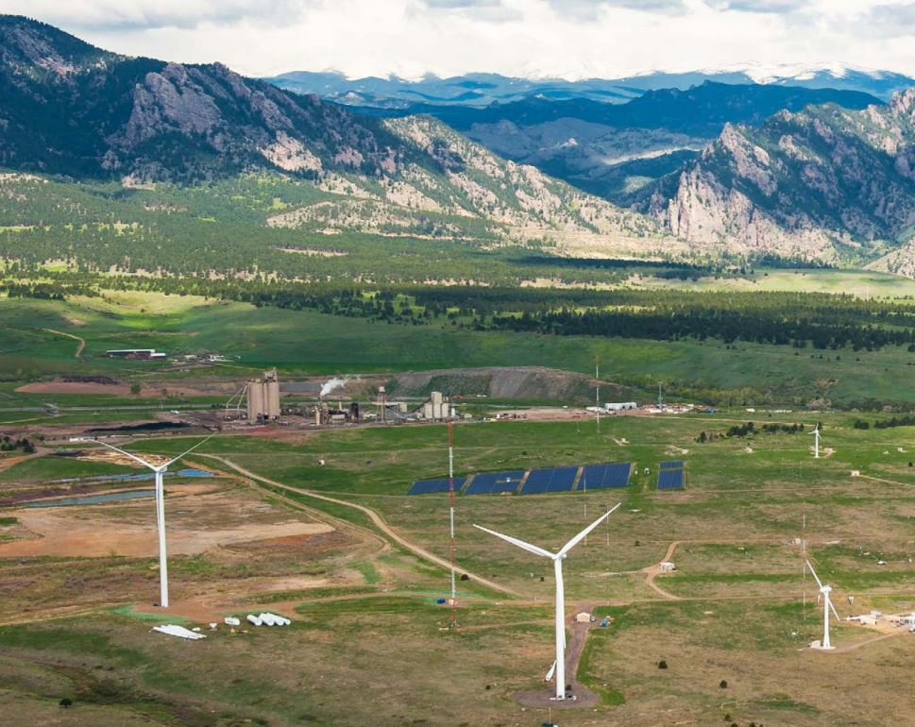
Periodic Wind Disturbance Rejection using Robust Individual Control Strategy
Yuan Yuan, X. Chen, J. Tang
Mar 5, 2018
Department of Mechanical Engineering
University of Connecticut
Storrs, CT, USA
Photo by NREL

Slide 7
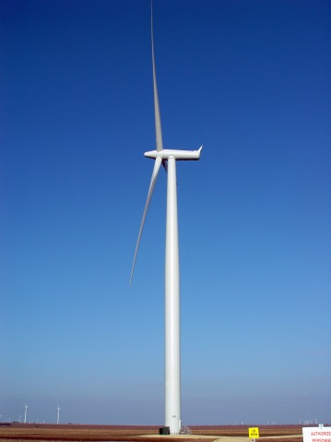
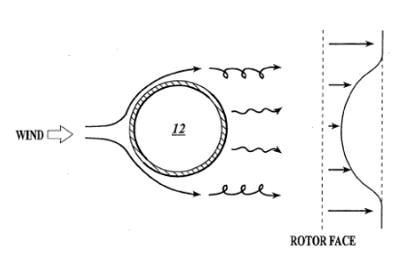
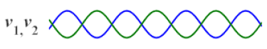
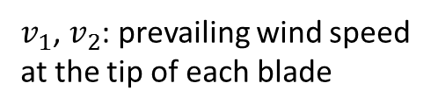
Motivation₁
Individual pitch control to mitigate periodic loads
Enabled by recent hardware advancements
Tower shadow and wind shear effects
Periodic loads
Tower shadow
Wind shear
different wind speed at different height
wind
wind
upwind turbine
downwind turbine
$v_{1}$, $v_{2}$: prevailing wind speed at the tip of each blade
Tower top

Slide 8
Control architecture formulation
Control architecture formulation
Collective loop:
Speed and power regulation
GSPI/DOB ^{[1]}
Individual loop:
Periodic load mitigation and modeling uncertainties
Robust control with weighting function selection
[1] Yuan, Y., Chen, X., and Tang, J., 2017, "Disturbance Observer-Based Pitch Control of Wind Turbines for Enhanced Speed Regulation," Journal of Dynamic Systems, Measurement, and Control, V139(7), pp. 071006.

Slide 9
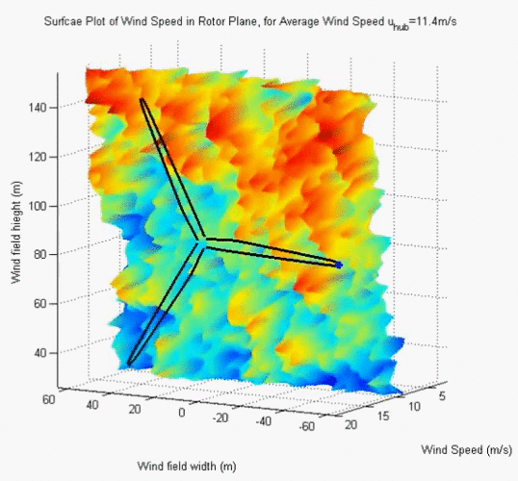
PSD results
PSD result analysis at multiple frequencies
18 m/s turbulent wind field excitation
Significant 1P, 2P, and 4P peak reduction

Slide 10
Load analysis
Blade and tower fatigue damage equivalent load (DEL) comparison
(DEL: industrial standard)
Collective control
PID individual control
Robust individual control
Blade flapwise: Robust: -20% of PID
Blade edgewise: same level
Tower base fore-aft: 3%-10% decrease
Tower base side-side: same level

